Slide 1
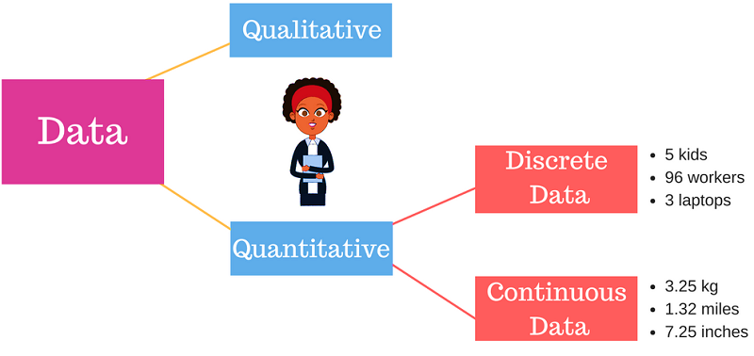
Discrete Structures vs Discrete Mathematics
Discrete Structures are structures that are used in describing discrete mathematics.
Discrete Mathematics is math that makes use of discrete structures.
"Discrete Math" OR "Discrete Structure" is not the name of a branch of mathematics, like number theory, algebra, calculus, etc. Rather, it's a description of a set of branches of math that all have in common the feature that they are "discrete" rather than "continuous".
FREE: For Complete Playlist: https://www.youtube.com/c/FahadHussaintutorial/playlists
For Code, Slide and Books: https://fahadhussaincs.blogspot.com/

Slide 2
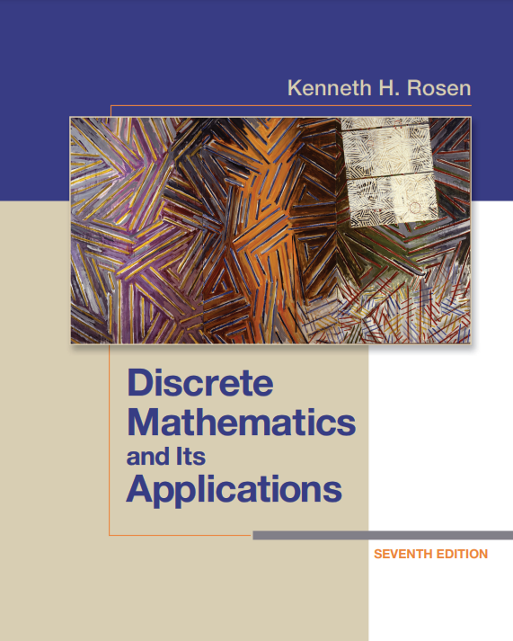
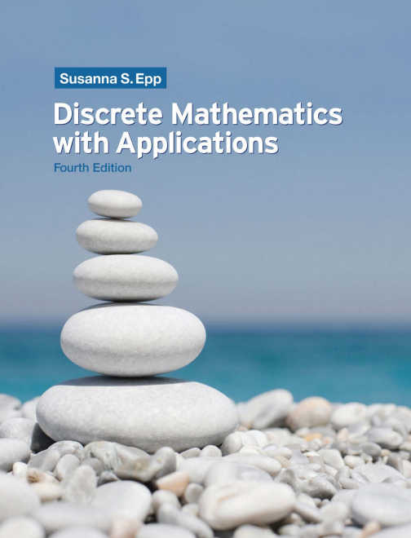
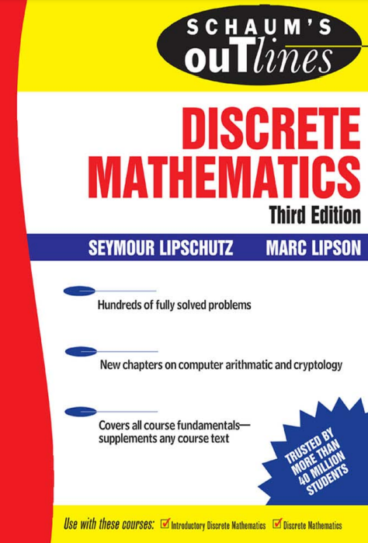
Recommended Books
Text Book
Discrete Mathematics and Its Applications
Kenneth H. Rosen
Incluiding Solution Manual
Reference Book:
Discrete Mathematics with Applications
Sausanna S.Epp
Discrete Mathematics
Schaums’ Outlines
FREE: For Complete Playlist: https://www.youtube.com/c/FahadHussaintutorial/playlists
For Code, Slide and Books: https://fahadhussaincs.blogspot.com/

Slide 3
Logic: Logic is the study of reasoning. It is the basic on which all the sentence are build. OR Correct and Incorrect reasoning.
A proposition is a declarative sentence (that is, a sentence that declares a fact) that is either true or false, but not both.
Imperative Declarative Interrogative
What time is it?
Read this carefully.
x + 1 = 2.
x + y = z
I am in Class.
Cat is bigger than Rat.
1 + 2 = 5
2 + 2 = 5
Propositional Logic:
The area of logic that deals with propositions.
FREE: For Complete Playlist: https://www.youtube.com/c/FahadHussaintutorial/playlists
For Code, Slide and Books: https://fahadhussaincs.blogspot.com/

Slide 4
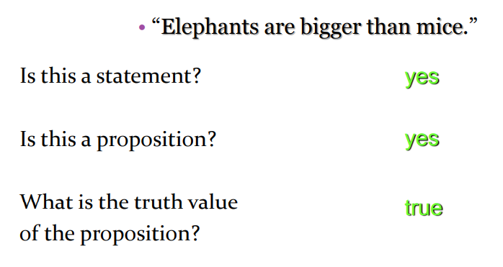
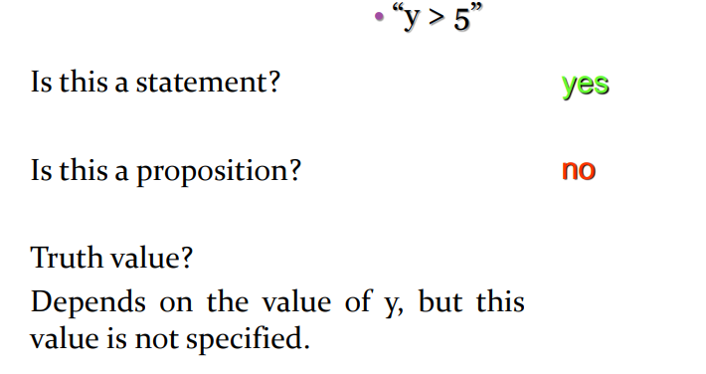
FREE: For Complete Playlist: https://www.youtube.com/c/FahadHussaintutorial/playlists
For Code, Slide and Books: https://fahadhussaincs.blogspot.com/

Slide 5
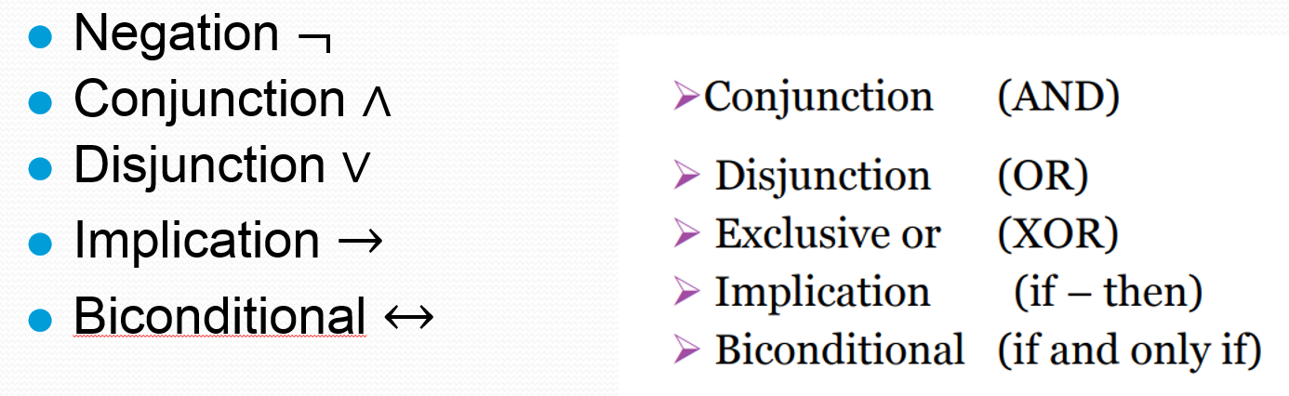
Compound Propositions Logical Connectives
I like A.I
Logical operators are used to form new propositions also called compound propositions from two or more existing propositions.
A truth table is a tabular representation of all the combinations of values for inputs and their corresponding outputs
FREE: For Complete Playlist: https://www.youtube.com/c/FahadHussaintutorial/playlists
For Code, Slide and Books: https://fahadhussaincs.blogspot.com/

Slide 6
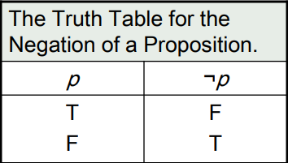
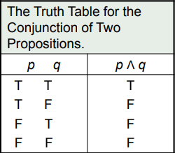
Negation
I am in NOT class
Cat cannot fly.
Today is Sunday.
Conjunction
Let p and q be propositions. The conjunction of p and q, denoted by p Λ q, is the proposition “p and q”. The conjunction p Λ q is true when both p and q are true and is false otherwise.
Today is Friday AND it is raining today.
I'd like pizza AND a salad for lunch.
FREE: For Complete Playlist: https://www.youtube.com/c/FahadHussaintutorial/playlists
For Code, Slide and Books: https://fahadhussaincs.blogspot.com/

Slide 7
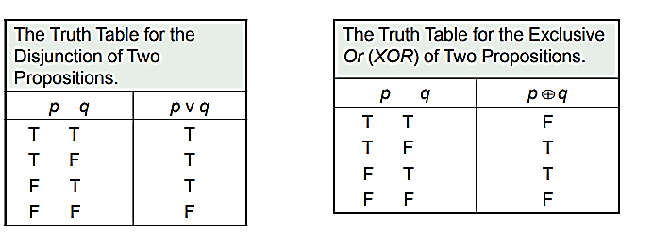
Disjunction
Let p and q be propositions. The disjunction of p and q, denoted by p ν q, is the proposition “p or q”. The disjunction p ν q is false when both p and q are false and is true otherwise.
Inclusive or : The disjunction is true when at least one of the two propositions is true.
“Students who have taken calculus or computer science can take this class.”
Exclusive or : The disjunction is true only when one of the proposition is true.
“Ice cream or pudding will be served after lunch.”
FREE: For Complete Playlist: https://www.youtube.com/c/FahadHussaintutorial/playlists
For Code, Slide and Books: https://fahadhussaincs.blogspot.com/

Slide 8
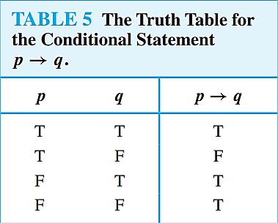
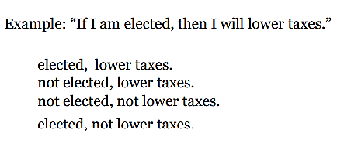
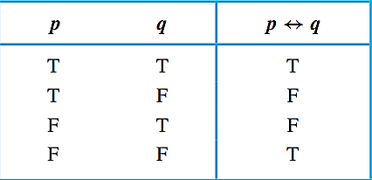
CONDITIONAL STATEMENT / IMPLICATION:
Let p and q be propositions. The conditional statement p → q, is the proposition “if p, then q” which is false when p is true and q is false, and true otherwise.
p is called the hypothesis (or antecedent or premise) and q is called the conclusion (or consequence).
CONDITIONAL STATEMENT / Bi-implications:
Let p and q be propositions. The biconditional statement p ↔ q is the proposition “p if and only if q.” The biconditional statement p ↔ q is true when p and q have the same truth values, and is false otherwise. Biconditional statements are also called bi-implications
“You can take the flight if and only if you buy a ticket.”
FREE: For Complete Playlist: https://www.youtube.com/c/FahadHussaintutorial/playlists
For Code, Slide and Books: https://fahadhussaincs.blogspot.com/

Slide 9
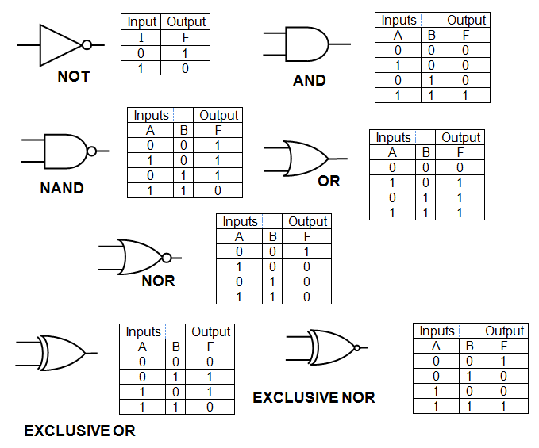
1.2.6 Logic Circuits – Logic Gate
FREE: For Complete Playlist: https://www.youtube.com/c/FahadHussaintutorial/playlists
For Code, Slide and Books: https://fahadhussaincs.blogspot.com/

Slide 10
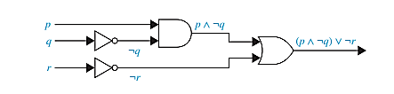
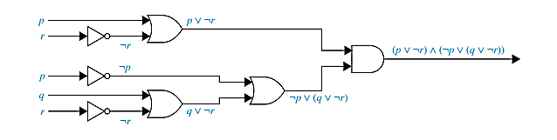
1.2.6 Logic Circuits – Logic Gate
(p ∧ ¬q) ∨ ¬r
(p ∨ ¬r) ∧ (¬p ∨ (q ∨ ¬r)).
FREE: For Complete Playlist: https://www.youtube.com/c/FahadHussaintutorial/playlists
For Code, Slide and Books: https://fahadhussaincs.blogspot.com/

Slide 11
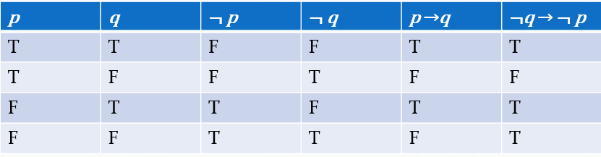
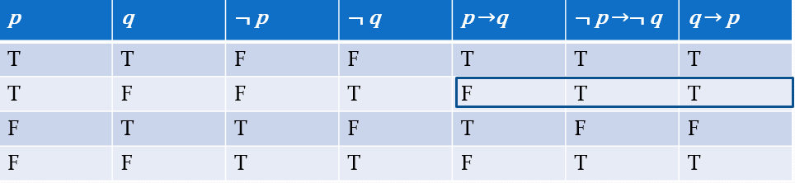
Other Conditional Statements:
If you are working hard, then you are a topper. Conditional
If you are a topper, then you are working hard. Converse
If you are not working hard, then you are not a topper. Inverse
If you are not topper, then you are not working hard. Contrapositive
Show using a truth table that the conditional is equivalent to the contrapositive.
Show using truth tables that neither the converse nor inverse of an implication are not equivalent to the implication.
FREE: For Complete Playlist: https://www.youtube.com/c/FahadHussaintutorial/playlists
For Code, Slide and Books: https://fahadhussaincs.blogspot.com/

Slide 12
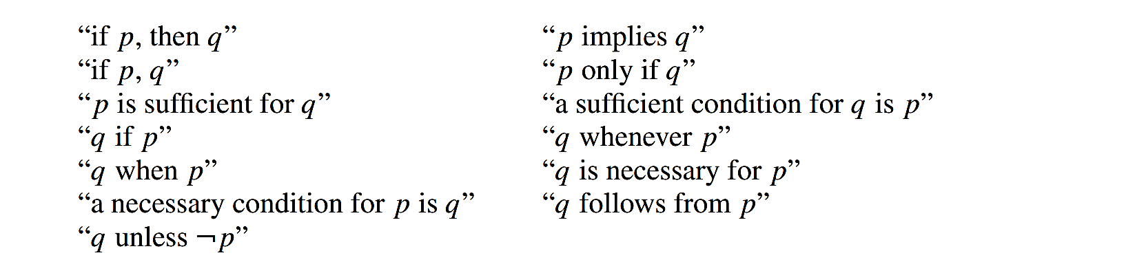
CONDITIONAL STATEMENT:
Different Ways of Expressing p →q
Let p and q be propositions. The conditional statement p → q is the proposition “if p, then q.” The conditional statement p → q is false when p is true and q is false, and true otherwise. In the conditional statement p → q, p is called the hypothesis (or antecedent or premise) and q is called the conclusion (or consequence).
FREE: For Complete Playlist: https://www.youtube.com/c/FahadHussaintutorial/playlists
For Code, Slide and Books: https://fahadhussaincs.blogspot.com/

Slide 13
Practice Time
Write each of these statements in the form “if p, then q” in English.
[Hint: Refer to the list of common ways to express conditional statements provided in this section.]
a) You send me an e-mail message only if I will remember to send you the address.
b) To be a citizen of this country, it is sufficient that you were born in the United States.
c) If you keep your textbook, it will be a useful reference in your future courses.
d) The Red Wings will win the Stanley Cup if their goalie plays well.
e) That you get the job implies that you had the best credentials.
f) The beach erodes whenever there is a storm.
g) It is necessary to have a valid password to log on to the server.
h) You will reach the summit unless you begin your climb too late.
FREE: For Complete Playlist: https://www.youtube.com/c/FahadHussaintutorial/playlists
For Code, Slide and Books: https://fahadhussaincs.blogspot.com/

Slide 14
Practice Time
Let p, q, and r be the propositions
p: You have the flu.
q: You miss the final examination.
r: You pass the course.
Express each of these propositions as an English sentence.
p → q
¬q ↔ r
q →¬r
d) p ∨ q ∨ r
e) (p →¬r) ∨ (q →¬r)
f) (p ∧ q) ∨ (¬q ∧ r)
FREE: For Complete Playlist: https://www.youtube.com/c/FahadHussaintutorial/playlists
For Code, Slide and Books: https://fahadhussaincs.blogspot.com/

Slide 15
Practice Time
Let p, q, and r be the propositions
p: You get an A on the final exam.
q: You do every exercise in this book.
r: You get an A in this class.
Write these propositions using p, q, and r and logical connectives.
a) You get an A in this class, but you do not do every exercise in this book.
b) You get an A on the final, you do every exercise in this book, and you get an A in this class.
c) To get an A in this class, it is necessary for you to get an A on the final.
d) You get an A on the final, but you don’t do every exercise in this book; nevertheless, you get an A in this class.
e) Getting an A on the final and doing every exercise in this book is sufficient for getting an A in this class.
f) You will get an A in this class if and only if you either do every exercise in this book or you get an A on the final.
FREE: For Complete Playlist: https://www.youtube.com/c/FahadHussaintutorial/playlists
For Code, Slide and Books: https://fahadhussaincs.blogspot.com/

Slide 16

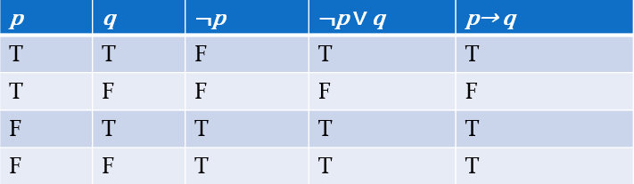
Propositional Equivalences, Law of Logic
A tautology is a proposition which is always true.
Example: p ∨¬p
A contradiction is a proposition which is always false.
Example: p ∧¬p
A contingency is a proposition which is neither a tautology nor a contradiction, such as p
Two compound propositions p and q are logically equivalent if p↔q is a tautology.
We write this as p⇔q or as p≡q where p and q are compound propositions.
Two compound propositions p and q are equivalent if and only if the columns in a truth table giving their truth values agree.
This truth table show ¬p ∨ q is equivalent to p → q.

Slide 17
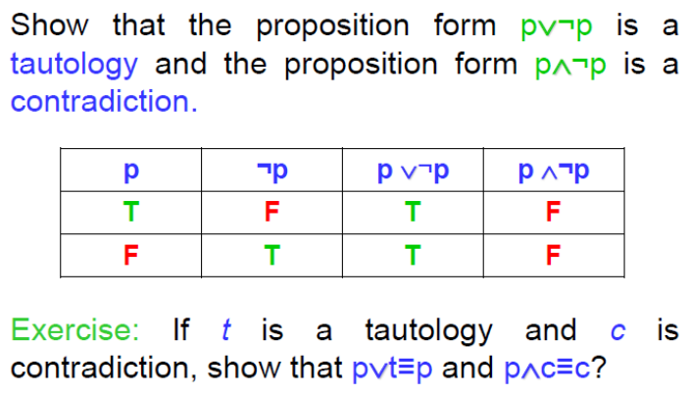
Propositional Equivalences, Law of Logic
Contradiction occurs when we get a statement p, such that p is true and its negation ~p is also true.
FREE: For Complete Playlist: https://www.youtube.com/c/FahadHussaintutorial/playlists
For Code, Slide and Books: https://fahadhussaincs.blogspot.com/

Slide 18
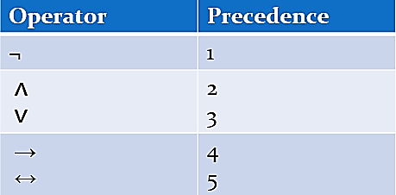
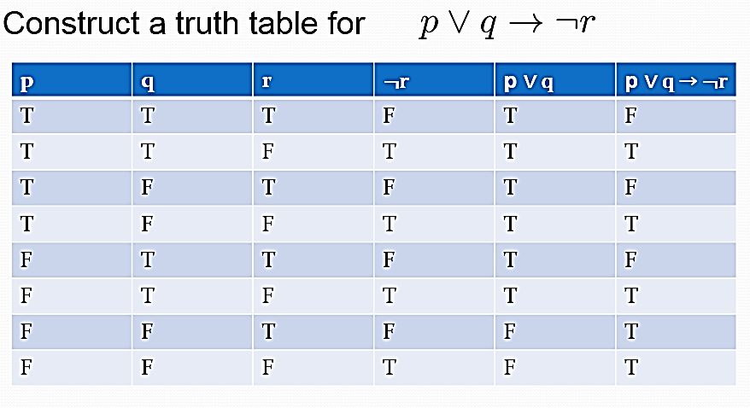
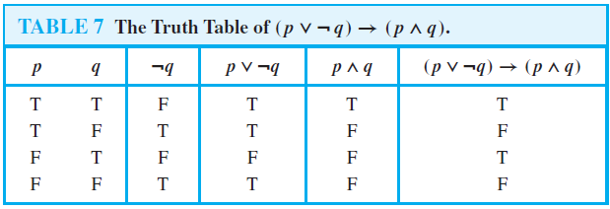
Truth Tables For Compound Propositions
FREE: For Complete Playlist: https://www.youtube.com/c/FahadHussaintutorial/playlists
For Code, Slide and Books: https://fahadhussaincs.blogspot.com/

Slide 19
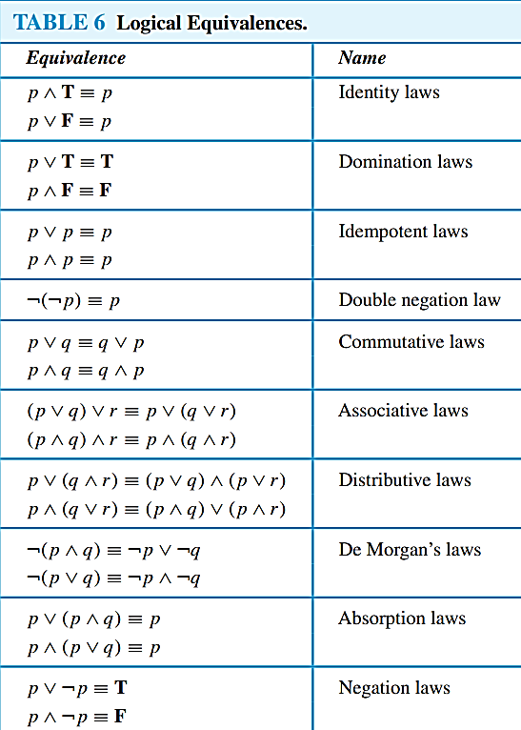
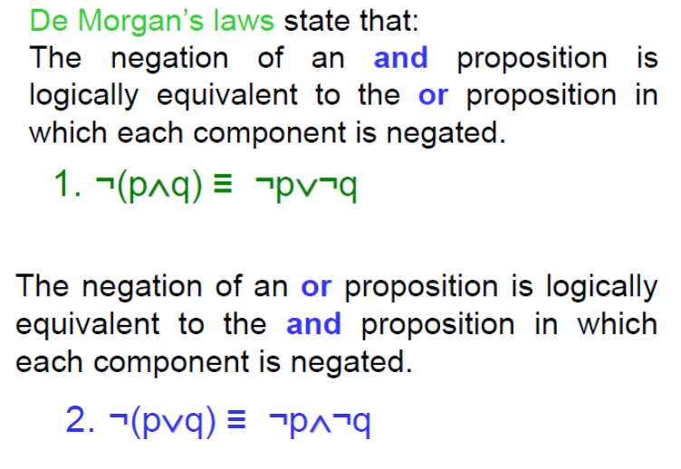
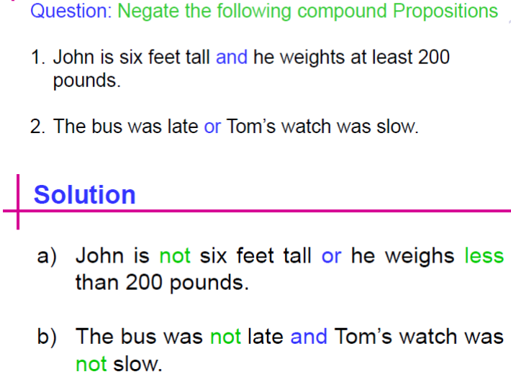
Propositional Equivalences, Law of Logic
FREE: For Complete Playlist: https://www.youtube.com/c/FahadHussaintutorial/playlists
For Code, Slide and Books: https://fahadhussaincs.blogspot.com/

Slide 20
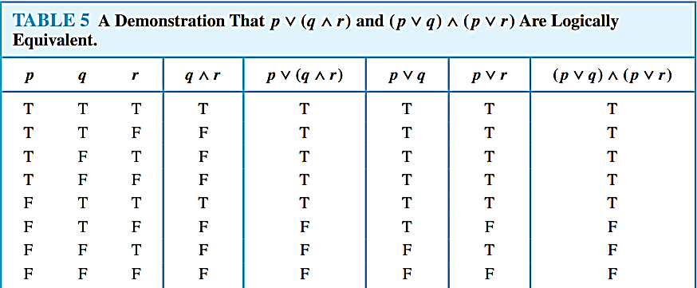
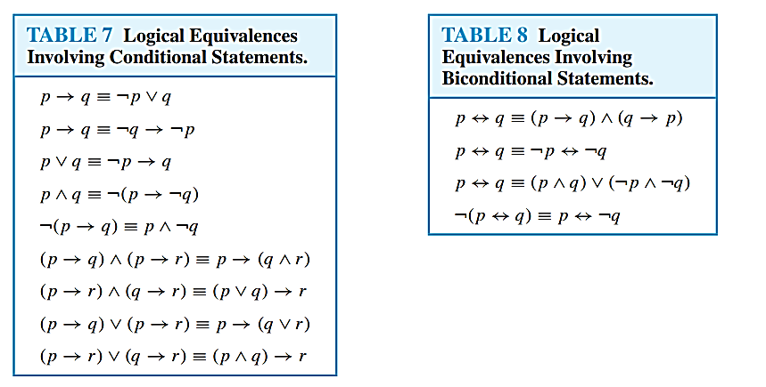
Propositional Equivalences, Law of Logic
FREE: For Complete Playlist: https://www.youtube.com/c/FahadHussaintutorial/playlists
For Code, Slide and Books: https://fahadhussaincs.blogspot.com/

Slide 21
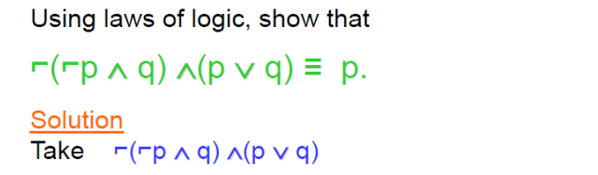
Propositional Equivalences, Law of Logic
FREE: For Complete Playlist: https://www.youtube.com/c/FahadHussaintutorial/playlists
For Code, Slide and Books: https://fahadhussaincs.blogspot.com/

Slide 22
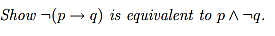
Propositional Equivalences, Law of Logic
Show that ¬(p ∨ ¬(p ∧ q)) is a contradiction
FREE: For Complete Playlist: https://www.youtube.com/c/FahadHussaintutorial/playlists
For Code, Slide and Books: https://fahadhussaincs.blogspot.com/

Slide 23
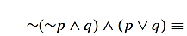
Propositional Equivalences, Law of Logic
FREE: For Complete Playlist: https://www.youtube.com/c/FahadHussaintutorial/playlists
For Code, Slide and Books: https://fahadhussaincs.blogspot.com/

Slide 24
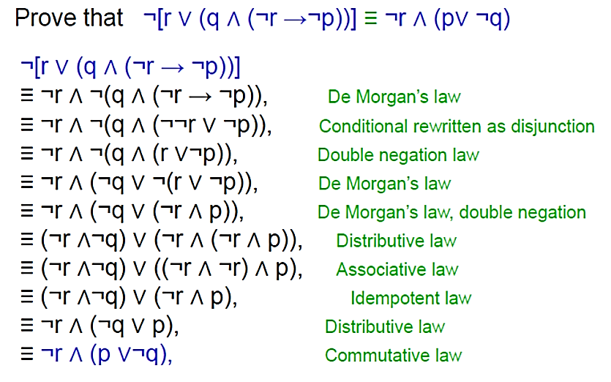
Propositional Equivalences, Law of Logic
FREE: For Complete Playlist: https://www.youtube.com/c/FahadHussaintutorial/playlists
For Code, Slide and Books: https://fahadhussaincs.blogspot.com/

Slide 25
Propositional Satisfiability
A compound proposition is satisfiable if there is an assignment of truth values to its variables that makes it true. When no such assignments exists, that is, when the compound proposition is false for all assignments of truth values to its variables, the compound proposition is unsatisfiable.
Note that a compound proposition is unsatisfiable if and only if its negation is true for all assignments of truth values to the variables, that is, if and only if its negation is a tautology
Satisfibale: A compound proposition is satisfiable if there is an assignment of truth values to its variables that makes it output true.
UnSatisfiable: If no such assignments exists i.e. compound proposition is equivalent to CONTRADICTION, then compound proposition is unsatisfiable .
Solution: Such assignment of truth value which makes a compound proposition satisfiable is called a solution of proposition.
A TRUTH TABLE can be used to determine whether a compound propositions is satisfiable .
FREE: For Complete Playlist: https://www.youtube.com/c/FahadHussaintutorial/playlists
For Code, Slide and Books: https://fahadhussaincs.blogspot.com/

Slide 26
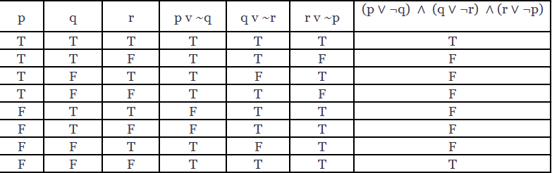
(p ∨ ¬q) ∧ (q ∨ ¬r) ∧ (r ∨ ¬p)
FREE: For Complete Playlist: https://www.youtube.com/c/FahadHussaintutorial/playlists
For Code, Slide and Books: https://fahadhussaincs.blogspot.com/

Slide 27
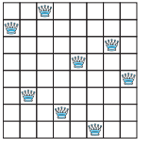
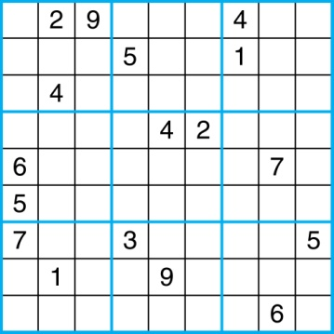
Notation
The n-Queens Problem
Sudoku
FREE: For Complete Playlist: https://www.youtube.com/c/FahadHussaintutorial/playlists
For Code, Slide and Books: https://fahadhussaincs.blogspot.com/

Slide 28
Predicates and Quantifiers
I am going to teach you Discrete Math.
x > 10
Predicate Function:
After assigning its become Proposition.
Truth Value:
“Quantifier”
FREE: For Complete Playlist: https://www.youtube.com/c/FahadHussaintutorial/playlists
For Code, Slide and Books: https://fahadhussaincs.blogspot.com/

Slide 29
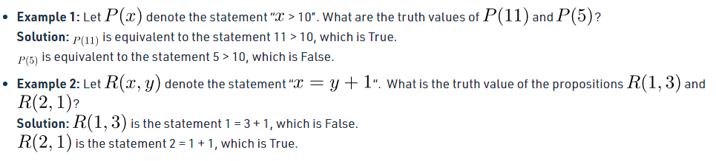
Predicates
Predicate Logic deals with predicates, which are propositions, consist of variables.
A predicate is a sentence that contains a finite number of variables and becomes a statement when specific values are substituted for the variables. The domain of a predicate variable is the set of all values that may be substituted in place of the variable.
Property of subject expression that contain variables
Why do we study it in DM, [to deal with variables]
Propositional Function
Predicate is also called propositional Function
Denote: P(Variable)
FREE: For Complete Playlist: https://www.youtube.com/c/FahadHussaintutorial/playlists
For Code, Slide and Books: https://fahadhussaincs.blogspot.com/

Slide 30
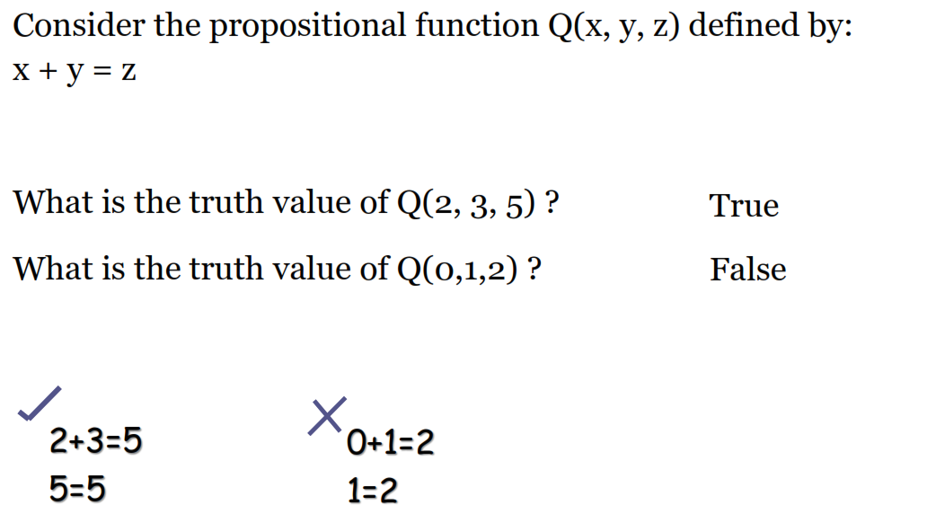
Predicates
FREE: For Complete Playlist: https://www.youtube.com/c/FahadHussaintutorial/playlists
For Code, Slide and Books: https://fahadhussaincs.blogspot.com/

Slide 31
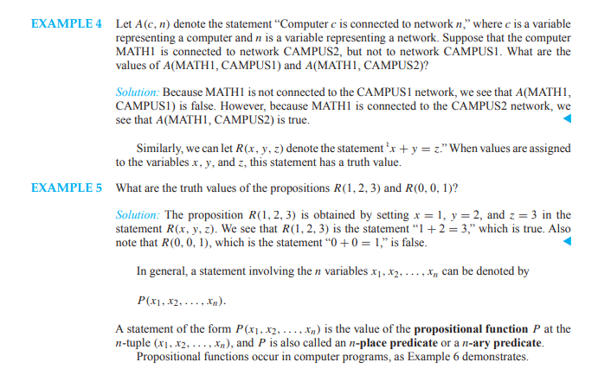
Predicates
FREE: For Complete Playlist: https://www.youtube.com/c/FahadHussaintutorial/playlists
For Code, Slide and Books: https://fahadhussaincs.blogspot.com/

Slide 32
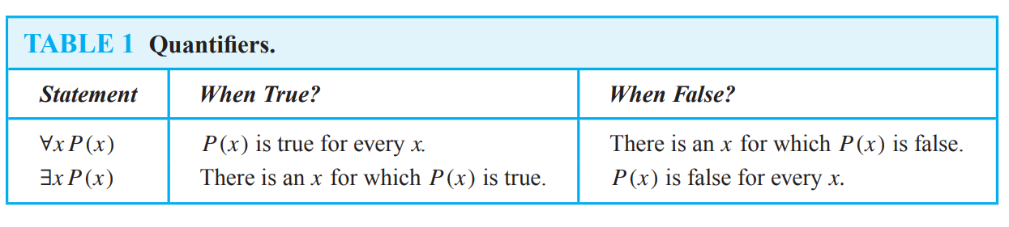
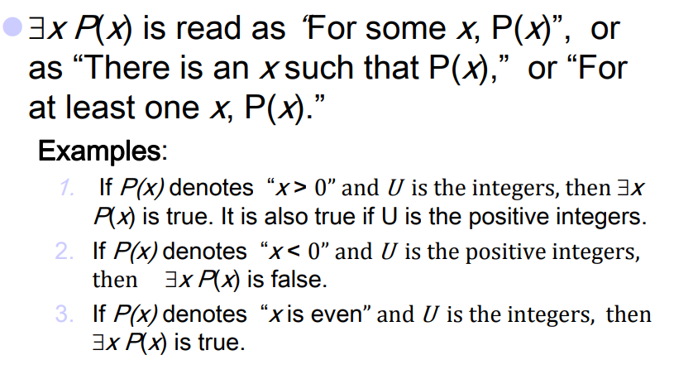
Predicates and Quantifiers
The variable of predicates is quantified by quantifiers. There are two types of quantifier in predicate logic - Existential Quantifier and Universal Quantifier.
FREE: For Complete Playlist: https://www.youtube.com/c/FahadHussaintutorial/playlists
For Code, Slide and Books: https://fahadhussaincs.blogspot.com/

Slide 33
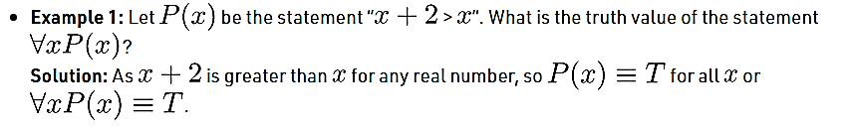
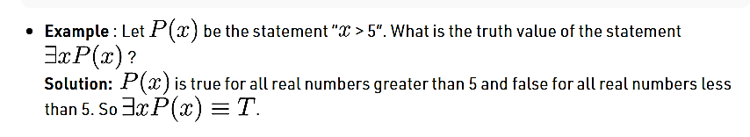
Quantifiers
FREE: For Complete Playlist: https://www.youtube.com/c/FahadHussaintutorial/playlists
For Code, Slide and Books: https://fahadhussaincs.blogspot.com/

Slide 34
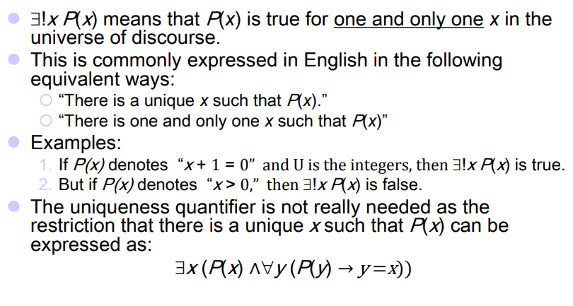
Quantifiers
FREE: For Complete Playlist: https://www.youtube.com/c/FahadHussaintutorial/playlists
For Code, Slide and Books: https://fahadhussaincs.blogspot.com/

Slide 35
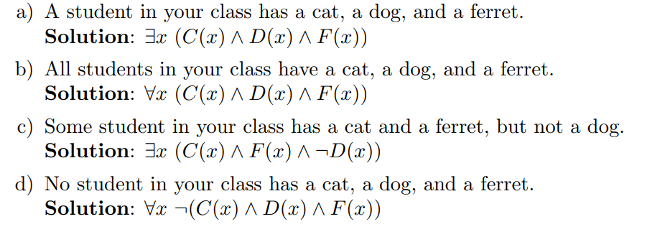
Quantifiers
Let C(x) be the statement “x has a cat,” let D(x) be the statement “x has a dog,” and let F(x) be the statement “x has a ferret.” Express each of these statements in terms of C(x), D(x), F(x), quantifiers, and logical connectives. Let the domain consist of all students in your class.
FREE: For Complete Playlist: https://www.youtube.com/c/FahadHussaintutorial/playlists
For Code, Slide and Books: https://fahadhussaincs.blogspot.com/

Slide 36
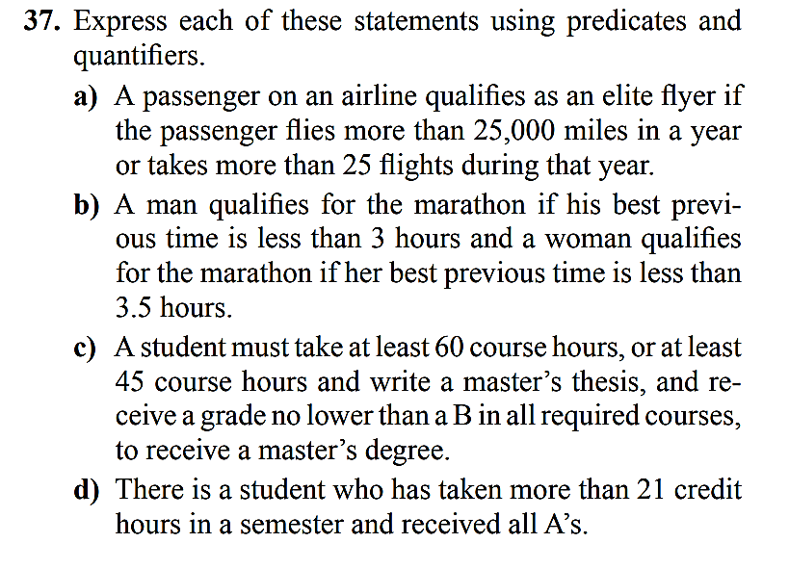
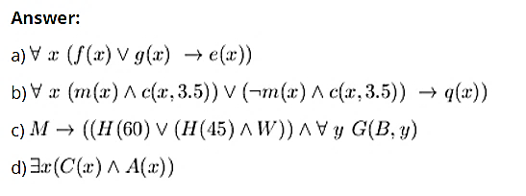
a)
f(x) : x is flying more than 25000 miles in a year
g(x) : x takes more than 25 flights during that year
e (x) : x qualifies as an elite flyer
b)
m(x): x is a man
c(x, y) : x has the change if previous time is less than y
q (x) : qualifies for the marathon
c)
M: received Master's degree
H(x): took x hours for the course
W: wrote thesis
G (x, y) : graded x or higher in course y
d)
c(x) : x taken more than 21 credit hours in a semester
A(x) : x has received all A
FREE: For Complete Playlist: https://www.youtube.com/c/FahadHussaintutorial/playlists
For Code, Slide and Books: https://fahadhussaincs.blogspot.com/

Slide 37
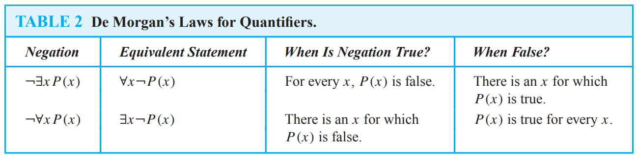
Negating Quantified Expressions
FREE: For Complete Playlist: https://www.youtube.com/c/FahadHussaintutorial/playlists
For Code, Slide and Books: https://fahadhussaincs.blogspot.com/

Slide 38
Quantifiers, De Morgan’s Laws for Quantifiers
What are the negations of the statements “There is an honest politician” and “All Americans eat cheeseburgers”?
Solution: Let H (x) denote “x is honest.” Then the statement “There is an honest politician” is represented by ∃x H (x), where the domain consists of all politicians. The negation of this statement is ¬∃x H(x), which is equivalent to ∀x ¬H(x).
This negation can be expressed as “Every politician is dishonest.”
(Note: In English, the statement “All politicians are not honest”
is ambiguous. In common usage, this statement often means
“Not all politicians are honest.”
Consequently, we do not use this statement to express this negation.)
FREE: For Complete Playlist: https://www.youtube.com/c/FahadHussaintutorial/playlists
For Code, Slide and Books: https://fahadhussaincs.blogspot.com/

Slide 39
Quantifiers, De Morgan’s Laws for Quantifiers
What are the negations of the statements ∀x(x2 > x) and ∃x(x2 = 2)?
Solution: The negation of ∀x(x2 > x) is the statement ¬∀x(x2 > x), which is equivalent to ∃x¬(x2 > x). This can be rewritten as ∃x(x2 ≤ x).
The negation of ∃x(x2 = 2) is the statement ¬∃x(x2 = 2), which is equivalent to ∀x¬(x2 = 2).
This can be rewritten as ∀x(x2 = 2).
The truth values of these statements depend on the domain.
Show that ¬∀x(P (x) → Q(x)) and ∃x(P (x) ∧ ¬Q(x)) are logically equivalent.
Solution: By De Morgan’s law for universal quantifiers, we know that
¬∀x(P (x) → Q(x)) and ∃x(¬(P (x) → Q(x))) are logically equivalent.
By the fifth logical equivalence, we know that ¬(P (x) → Q(x)) and P (x) ∧ ¬Q(x) are logically equivalent for every x. Because we can substitute one logically equivalent expression for another in a logical equivalence, it follows that ¬∀x(P (x) → Q(x)) and ∃x(P (x) ∧ ¬Q(x)) are logically equivalent.
FREE: For Complete Playlist: https://www.youtube.com/c/FahadHussaintutorial/playlists
For Code, Slide and Books: https://fahadhussaincs.blogspot.com/

Slide 40
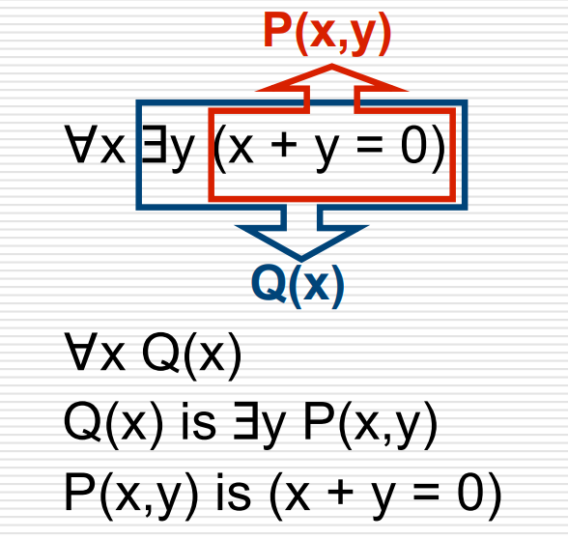
Nested Quantifiers
Two quantifiers are nested if one is within the scope of the other.
∀x ∃y(x + y = 0)
∀x ∀y(x + y = y + x)
∀x ∀y ∀z(x + (y + z) = (x + y) + z)
∀x ∀y((x > 0) ∧ (y < 0) → (xy < 0))
FREE: For Complete Playlist: https://www.youtube.com/c/FahadHussaintutorial/playlists
For Code, Slide and Books: https://fahadhussaincs.blogspot.com/

Slide 41
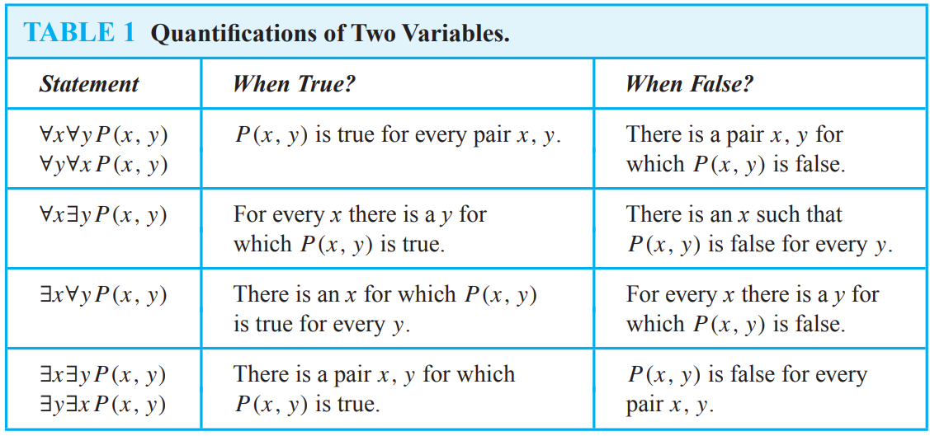
Nested Quantifiers, Orders
∀x ∀y P(x y)
∀x ∃y P(x y)
∃x ∀y P(x y)
∃x ∃y P(x y)
So, we concluded the new concept of Equivalency here as well.
FREE: For Complete Playlist: https://www.youtube.com/c/FahadHussaintutorial/playlists
For Code, Slide and Books: https://fahadhussaincs.blogspot.com/

Slide 42

Nested Quantifiers, Questions
This says that there exists a real number x such that for every real number y, the product xy equals y. That is, there is a multiplicative identity for the real numbers. This is a true statement, since x = 1 is the identity.
b) The product of two negative real numbers is always a positive real number.
c) There exist real numbers x and y such that x² exceeds y but x is less than y. This is true, since we can take x =2 and y =3, for instance.
d) This says that for every pair of real numbers x and y , there exists a real number z that is their sum. In other words, the real numbers are closed under the operation of addition, another true fact. (Some authors would include the uniqueness of z as part of the meaning of the word closed.)
FREE: For Complete Playlist: https://www.youtube.com/c/FahadHussaintutorial/playlists
For Code, Slide and Books: https://fahadhussaincs.blogspot.com/

Slide 43

Nested Quantifiers, Questions
Negating Nested Quantifiers
FREE: For Complete Playlist: https://www.youtube.com/c/FahadHussaintutorial/playlists
For Code, Slide and Books: https://fahadhussaincs.blogspot.com/

Slide 44
Rules of Inference
Proofs in mathematics are valid arguments that establish the truth of mathematical statements. By an argument, we mean a sequence of statements that end with a conclusion. By valid, we mean that the conclusion, or final statement of the argument, must follow from the truth of the preceding statements, or premises, of the argument..
A rule of inference, inference rule or transformation rule is a logical form consisting of a function which takes premises, analyzes their syntax, and returns a conclusion (or conclusions).
Valid Arguments in Propositional Logic
“If you have a current password, then you can log onto the network.”
“You have a current password.”
Therefore,
“You can log onto the network.”
FREE: For Complete Playlist: https://www.youtube.com/c/FahadHussaintutorial/playlists
For Code, Slide and Books: https://fahadhussaincs.blogspot.com/

Slide 45

Rules of Inference for Propositional Logic
FREE: For Complete Playlist: https://www.youtube.com/c/FahadHussaintutorial/playlists
For Code, Slide and Books: https://fahadhussaincs.blogspot.com/

Slide 46


Rules of Inference for Propositional Logic
Modus Ponens:
The Modus Ponens rule is one of the most important rules of inference, and it states that if P and P → Q is true, then we can infer that Q will be true. It can be represented as:
Example:
Statement-1: "If I am sleepy then I go to bed" ==> P→ Q
Statement-2: "I am sleepy" ==> P
Conclusion: "I go to bed." ==> Q.
Hence, we can say that, if P→ Q is true and P is true then Q will be true.
Modus Tollens:
The Modus Tollens rule state that if P→ Q is true and ¬ Q is true, then ¬ P will also true. It can be represented as:
Statement-1: "If I am sleepy then I go to bed" ==> P→ Q
Statement-2: "I do not go to the bed."==> ~Q
Statement-3: Which infers that "I am not sleepy" => ~P
FREE: For Complete Playlist: https://www.youtube.com/c/FahadHussaintutorial/playlists
For Code, Slide and Books: https://fahadhussaincs.blogspot.com/

Slide 47

Rules of Inference for Propositional Logic
Hypothetical Syllogism:
The Hypothetical Syllogism rule state that if P→R is true whenever P→Q is true, and Q→R is true. It can be represented as the following notation:
Example:
Statement-1: If you have my home key then you can unlock my home. P→Q
Statement-2: If you can unlock my home then you can take my money. Q→R
Conclusion: If you have my home key then you can take my money. P→R
FREE: For Complete Playlist: https://www.youtube.com/c/FahadHussaintutorial/playlists
For Code, Slide and Books: https://fahadhussaincs.blogspot.com/

Slide 48


Rules of Inference for Propositional Logic
Disjunctive Syllogism:
The Disjunctive syllogism rule state that if P∨Q is true, and ¬P is true, then Q will be true. It can be represented as:
Example:
Statement-1: Today is Sunday or Monday. ==>P∨Q
Statement-2: Today is not Sunday. ==> ¬P
Conclusion: Today is Monday. ==> Q
Addition:
The Addition rule is one the common inference rule, and it states that If P is true, then P∨Q will be true.
Example:
Statement: I have a vanilla ice-cream. ==> P
Statement-2: I have Chocolate ice-cream.
Conclusion: I have vanilla or chocolate ice-cream. ==> (P∨Q)
FREE: For Complete Playlist: https://www.youtube.com/c/FahadHussaintutorial/playlists
For Code, Slide and Books: https://fahadhussaincs.blogspot.com/

Slide 49


Rules of Inference for Propositional Logic
Simplification:
The simplification rule state that if P∧ Q is true, then Q or P will also be true. It can be represented as:
Resolution:
The Resolution rule state that if P∨Q and ¬ P∧R is true, then Q∨R will also be true. It can be represented as
FREE: For Complete Playlist: https://www.youtube.com/c/FahadHussaintutorial/playlists
For Code, Slide and Books: https://fahadhussaincs.blogspot.com/

Slide 50

Using Rules of Inference to Build Arguments
Show that the premises “It is not sunny this afternoon and it is colder than yesterday,” “We will go swimming only if it is sunny,” “If we do not go swimming, then we will take a canoe trip,” and “If we take a canoe trip, then we will be home by sunset” lead to the conclusion “We will be home by sunset.”
Let p be the proposition “It is sunny this afternoon,” q the proposition “It is colder than yesterday,” r the proposition “We will go swimming,” s the proposition “We will take a canoe trip,” and t the proposition “We will be home by sunset.” Then the premises become ¬p ∧ q,r → p, ¬r → s, and s → t. The conclusion is simply t. We need to give a valid argument with premises ¬p ∧ q, r → p, ¬r → s, and s → t and conclusion t.
We construct an argument to show that our premises lead to the desired conclusion as follows.
FREE: For Complete Playlist: https://www.youtube.com/c/FahadHussaintutorial/playlists
For Code, Slide and Books: https://fahadhussaincs.blogspot.com/

Slide 51

Using Rules of Inference to Build Arguments
Show that the premises “If you send me an e-mail message, then I will finish writing the program,” “If you do not send me an e-mail message, then I will go to sleep early,” and “If I go to sleep early, then I will wake up feeling refreshed” lead to the conclusion “If I do not finish writing the program, then I will wake up feeling refreshed.”
Solution: Let p be the proposition “You send me an e-mail message,” q the proposition “I will finish writing the program,” r the proposition “I will go to sleep early,” and s the proposition “I will wake up feeling refreshed.” Then the premises are p → q, ¬p → r, and r → s. The desired conclusion is ¬q → s. We need to give a valid argument with premises p → q, ¬p → r, and r → s and conclusion ¬q → s.
This argument form shows that the premises lead to the desired conclusion.
FREE: For Complete Playlist: https://www.youtube.com/c/FahadHussaintutorial/playlists
For Code, Slide and Books: https://fahadhussaincs.blogspot.com/

Slide 52
Resolution
Computer programs have been developed to automate the task of reasoning and proving theorems. Many of these programs make use of a rule of inference known as resolution. This rule of inference is based on the tautology Links.
The Resolution Principle are used to prove whether an argument is CORRECT OR NOT.
Literal: A variable or negation of a variable is called a literal.
Clause: A clause is a disjunction of literals.
((p ∨ q) ∧ (¬p ∨ r)) → (q ∨ r).
The final disjunction in the resolution rule, q ∨ r, is called the Resolvent.
When we let q = r in this tautology, we obtain (p ∨ q) ∧ (¬p ∨ q) → q. Furthermore, when we let r = F, we obtain (p ∨ q) ∧ (¬p) → q (because q ∨ F ≡ q), which is the tautology on which the rule of disjunctive syllogism is based.
FREE: For Complete Playlist: https://www.youtube.com/c/FahadHussaintutorial/playlists
For Code, Slide and Books: https://fahadhussaincs.blogspot.com/

Slide 53
Resolution
Use resolution to show that the hypotheses “Jasmine is skiing or it is not snowing” and “It is snowing or Bart is playing hockey” imply that “Jasmine is skiing or Bart is playing hockey.”
Solution: Let p be the proposition “It is snowing,” q the proposition “Jasmine is skiing,” and r the proposition “Bart is playing hockey.” We can represent the hypotheses as ¬p ∨ q and p ∨ r, respectively. Using resolution, the proposition q ∨ r, “Jasmine is skiing or Bart is playing hockey,” follows.
Show that the premises (p ∧ q) ∨ r and r → s imply the conclusion p ∨ s.
Solution: We can rewrite the premises (p ∧ q) ∨ r as two clauses, p ∨ r and q ∨ r. We can also replace r → s by the equivalent clause ¬r ∨ s. Using the two clauses p ∨ r and ¬r ∨ s, we can use resolution to conclude p ∨ s.
FREE: For Complete Playlist: https://www.youtube.com/c/FahadHussaintutorial/playlists
For Code, Slide and Books: https://fahadhussaincs.blogspot.com/

Slide 54
Fallacies
There are some common arguments which are invalid. Though at first glace, they seem right. Such a type of argument is known as Fallary.
The proposition ((p → q) ∧ q) → p is not a tautology, because it is false when p is false and q is true. However, there are many incorrect arguments that treat this as a tautology.
In other Links words, they treat the argument with premises p → q and q and conclusion p as a valid argument form, which it is not. This type of incorrect reasoning is called the fallacy of affirming the
conclusion.
FREE: For Complete Playlist: https://www.youtube.com/c/FahadHussaintutorial/playlists
For Code, Slide and Books: https://fahadhussaincs.blogspot.com/

Slide 55
Fallacies
Is the following argument valid?
If you do every problem in this book, then you will learn discrete mathematics.
You learned discrete mathematics.
Therefore,
you did every problem in this book.
Solution: Let p be the proposition “You did every problem in this book.” Let q be the proposition “You learned discrete mathematics.” Then this argument is of the form: if p → q and q, then p.
This is an example of an incorrect argument using the fallacy of affirming the conclusion. Indeed, it is possible for you to learn discrete mathematics in some way other than by doing every problem in this book. (You may learn discrete mathematics by reading, listening to lectures, doing some, but not all, the problems in this book, and so on.)
The proposition ((p → q) ∧ ¬p) → ¬q is not a tautology, because it is false when p is false and q is true. Many incorrect arguments use this incorrectly as a rule of inference.
This type of incorrect reasoning is called the fallacy of denying the hypothesis.
FREE: For Complete Playlist: https://www.youtube.com/c/FahadHussaintutorial/playlists
For Code, Slide and Books: https://fahadhussaincs.blogspot.com/

Slide 56
Rules of Inference for Quantified Statements
We have discussed rules of inference for propositions. We will now describe some important rules of inference for statements involving quantifiers. These rules of inference are used extensively in mathematical arguments, often without being explicitly mentioned.
Universal instantiation is the rule of inference used to conclude that P(c) is true, where c is a particular member of the domain, given the premise ∀xP(x). Universal instantiation is used when we conclude from the statement “All women are wise” that “Lisa is wise,” where Lisa is a member of the domain of all women.
Universal generalization is the rule of inference that states that ∀xP(x) is true, given the premise that P(c) is true for all elements c in the domain. Universal generalization is used when we show that ∀xP(x) is true by taking an arbitrary element c from the domain and showing that P(c) is true. The element c that we select must be an arbitrary, and not a specific, element of the domain. That is, when we assert from ∀xP(x) the existence of an element c in the domain,
FREE: For Complete Playlist: https://www.youtube.com/c/FahadHussaintutorial/playlists
For Code, Slide and Books: https://fahadhussaincs.blogspot.com/

Slide 57

Rules of Inference for Quantified Statements
FREE: For Complete Playlist: https://www.youtube.com/c/FahadHussaintutorial/playlists
For Code, Slide and Books: https://fahadhussaincs.blogspot.com/

Slide 58

Rules of Inference for Quantified Statements
FREE: For Complete Playlist: https://www.youtube.com/c/FahadHussaintutorial/playlists
For Code, Slide and Books: https://fahadhussaincs.blogspot.com/

Slide 59

Rules of Inference for Quantified Statements
Show that the premises “A student in this class has not read the book,” and “Everyone in this class passed the first exam” imply the conclusion “Someone who passed the first exam has not read the book.”
FREE: For Complete Playlist: https://www.youtube.com/c/FahadHussaintutorial/playlists
For Code, Slide and Books: https://fahadhussaincs.blogspot.com/

